Slide 1
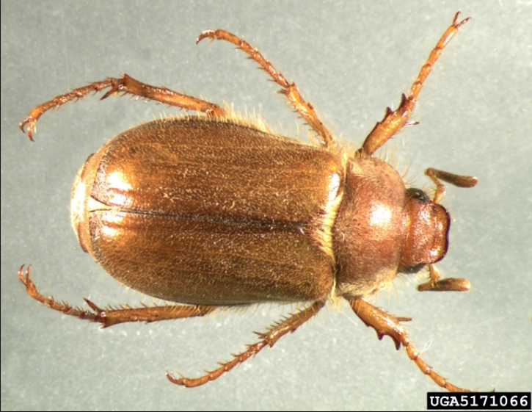
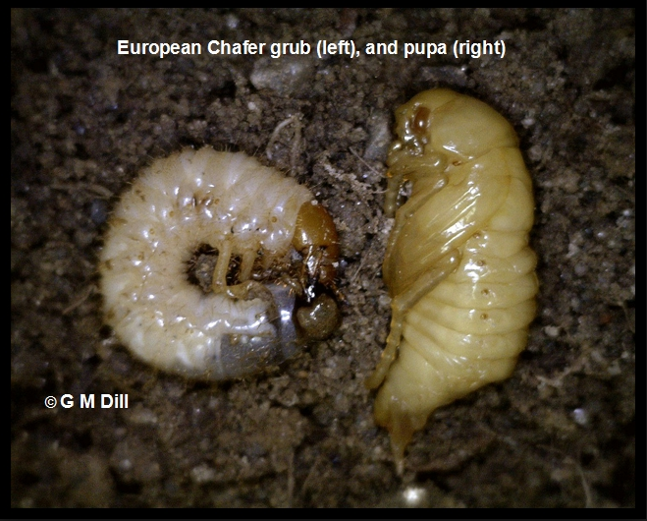
European Chafer Beetle Damage

Slide 2
Where is it from?
The European chafer is an introduced species, native to Western and Central Europe.
First found in BC lower mainland in 2002
In May 2011 identified in Fredericton by RG & DM
Also found in Ont., Que., NS.
Probably arrived in potted plants
As people share plants, they move the larvae from place to place.
Less than ten years to cross Canada!! Natural movement by female flying would be < 1 km/year.

Slide 3
Introduced – Invasive Pest
The European chafer is an introduced species, native to Western and Central Europe. It is the grub that can cause the most serious damage to turf grass. Mature grubs can reach approx. 25 mm in length.
Mature grubs are the size of a piece of cooked elbow macaroni.

Slide 4
What Does It look like?
The mature adult beetles are approximately 14 mm long and a tan colour. The adults swarm in large numbers around trees at dusk in mid to late July, but will not cause significant feeding damage to plants or trees.
The adult beetle is photo-positive which means it will find you if you leave an outside light on at night.

Slide 5
Larvae or Grub Stage
Grubs eat the crown of the grass roots, killing the plant.
Whole lawns can be damaged/destroyed in a two week period in early May.
Most homeowners are shocked when they see the damage.

Slide 6
For any control plan, you need to know the Life-Cycle
Third in-star
Overwinter as a grub deep in the soil below frost line.
Return to surface and continue feeding in May. Damage will be very apparent by mid-May.
Pupate in the soil and emerge as beetle in late June, early July
Adults mate and lay eggs in soil.
Larvae feeds on grass roots from late July into September.

Slide 7
Other Facts!
Female chafers lay 20-40 eggs over their lifespan & eggs take 2 weeks to hatch.
The grub population consists mainly of first instars in early August, second instars by late August / early September, and third instars by mid-September to late September.
The most vigorous feeding occurs from late April into mid-May.
Assuming 0% mortality
Year 1: 20 females lay 40 eggs each. 50% females – 50% males
Year 2: 400 females lay 40 eggs. 8000 female grubs.
Year 3: 8000 females lay 40 eggs. Total of 320,000 grubs!
Year 4: 160,000 females lay 6.4 million grubs

Slide 8
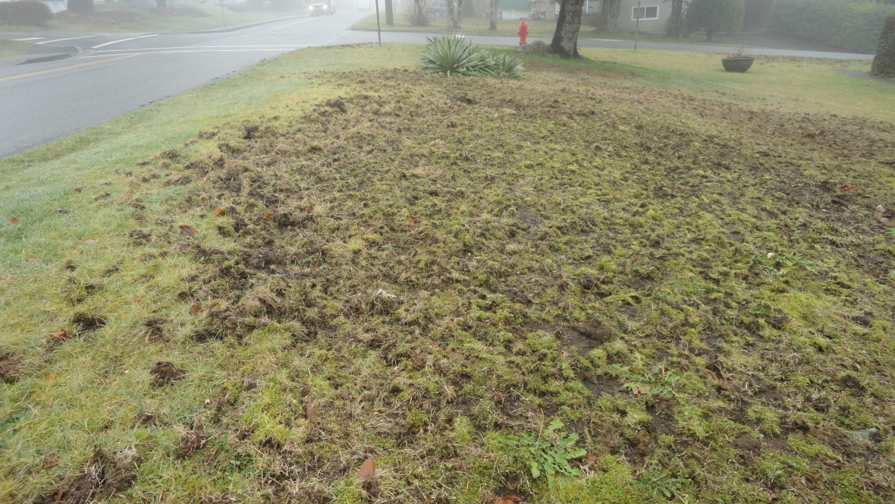
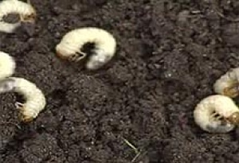
If your lawn looks like this….

Slide 9
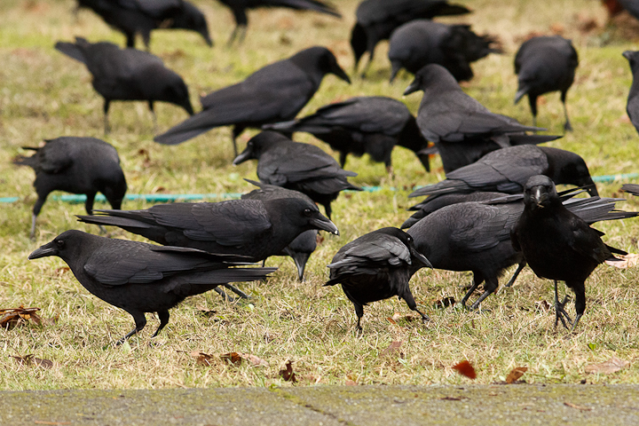
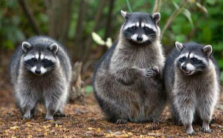
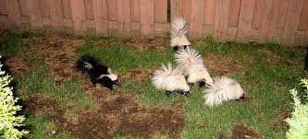
And you notice additional bird and animal traffic……

Slide 10
Do A Turf Test
If animals are feasting in your lawn, there's a good chance you've got chafer beetles.
Here’s a simple test:
Cut three sides of a 12 inch x 12 inch square patch of the problem area and roll back the turf.
Look for white, c-shaped grubs about the size of a dime.
Repeat up to five times in different areas.
If you find more than 5 grubs per square foot, consider taking action.

Slide 11
Options: Apply Nematodes
Beneficial nematodes are tiny parasites that enter beetle larvae and kill them. Nematodes must be applied during a specific window (late july, early august) when the grubs are young.
You must keep your turf moist for a period following application.
Don’t apply during bright sunlight as UV kills nematodes.

Slide 12
Available Locally!
Apply through a sprayer
Covers 3000 ft²
Water the nematodes into the lawn as UV rays kill them
~$33 at local stores

Slide 13
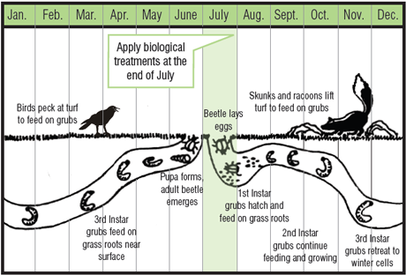
Apply nematodes soon after you see the adult beetle. Follow instructions!!

Slide 14
Let the predators go at the grubs...for now.
If birds and raccoons are digging up your lawn, there's not much point in trying to stop them. It may be to your advantage to let them eat as many of the grubs as possible to help bring down the population before you apply nematode treatments mid-summer and start to restore your lawn.
People are using contact pesticides but some of these are Neonicotinoids which kill bees and other pollinators.

Slide 15
Options Re-Seed Your Lawn
With a lawn rake, rake up all dead and loose turf.
With a garden rake, rough up the soil and re-seed with a good quality grass seed mixture.
Top dress with appropriate growing medium if needed.
Water regularly until seed has germinated. Further water if we don’t get regular rainfall.
Be prepared to repeat next year if the grub population is still there.

Slide 16
PREVENTATIVE MEASURES Keep your grass long and healthy
Chafer beetles are less likely to lay eggs in healthy grass. Regular fertilization and liming, proper aeration, and keeping grass longer will help. Mow grass at 3” or longer and use a mulching blade.

Slide 17
Consider Alternatives
Some homeowners are replacing beetle-infested lawns with vegetable gardens, alternative landscaping and hardscaping, and even synthetic turf.
For the majority who still want a lawn, micro-clover, tall fescue, creeping thyme are some of the hardier, beetle-resistant options.

Slide 18
Don't Expect a Magic Bullet
There is no magic solution!
A combination of good lawn care and proper nematode application can help alleviate the damage.
A grass lawn is a monoculture of plants and is very susceptible to insect and disease attack.
A bit of patience helps too.

Slide 19
